Slide 1
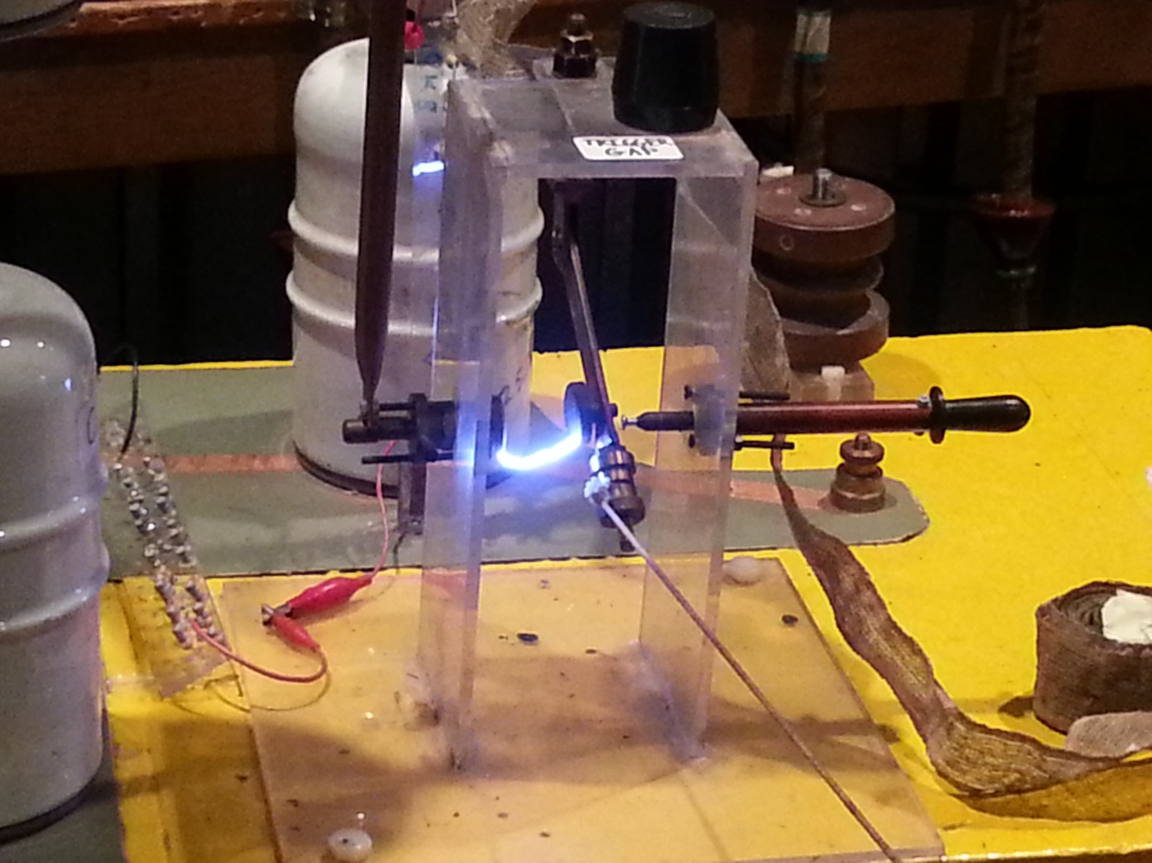

Slide 2
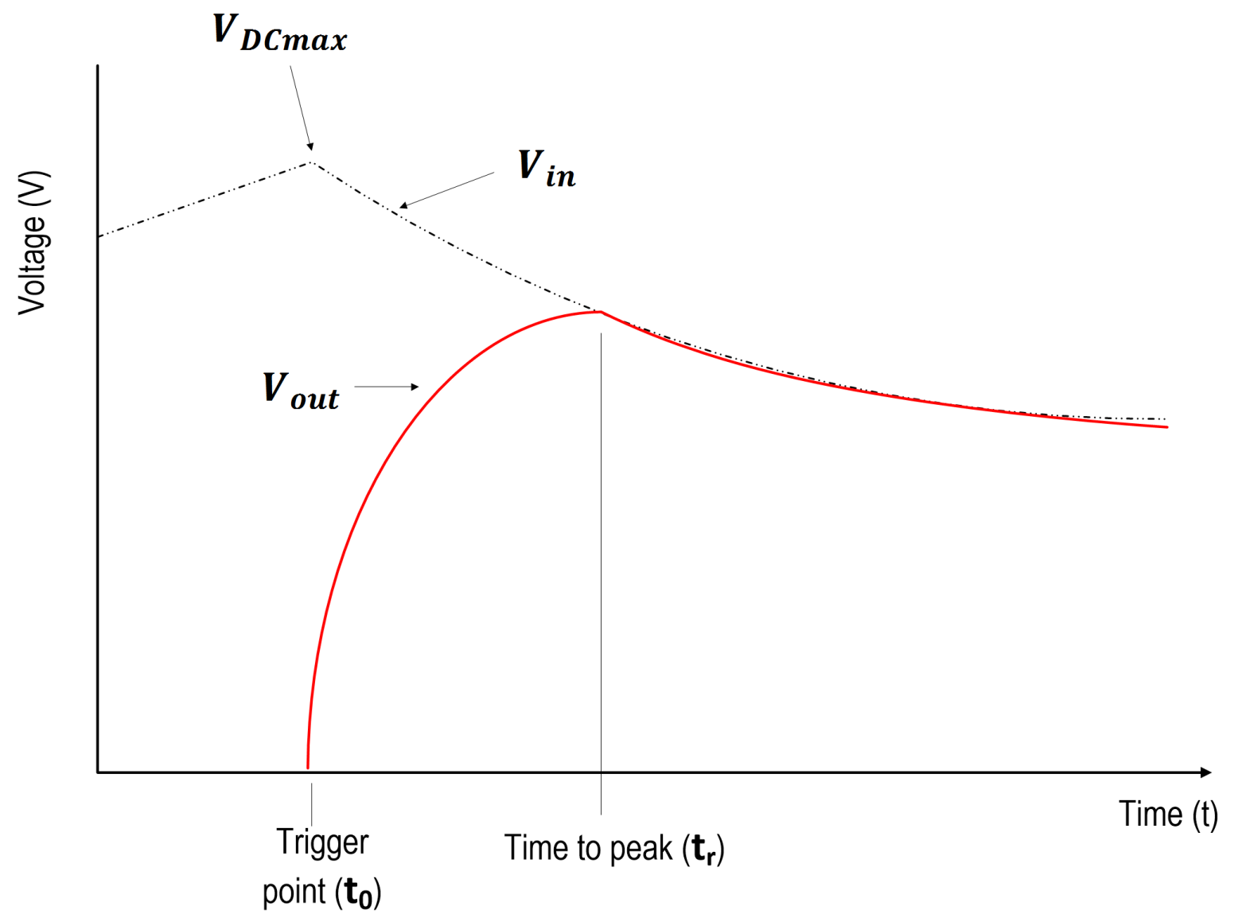

Slide 3
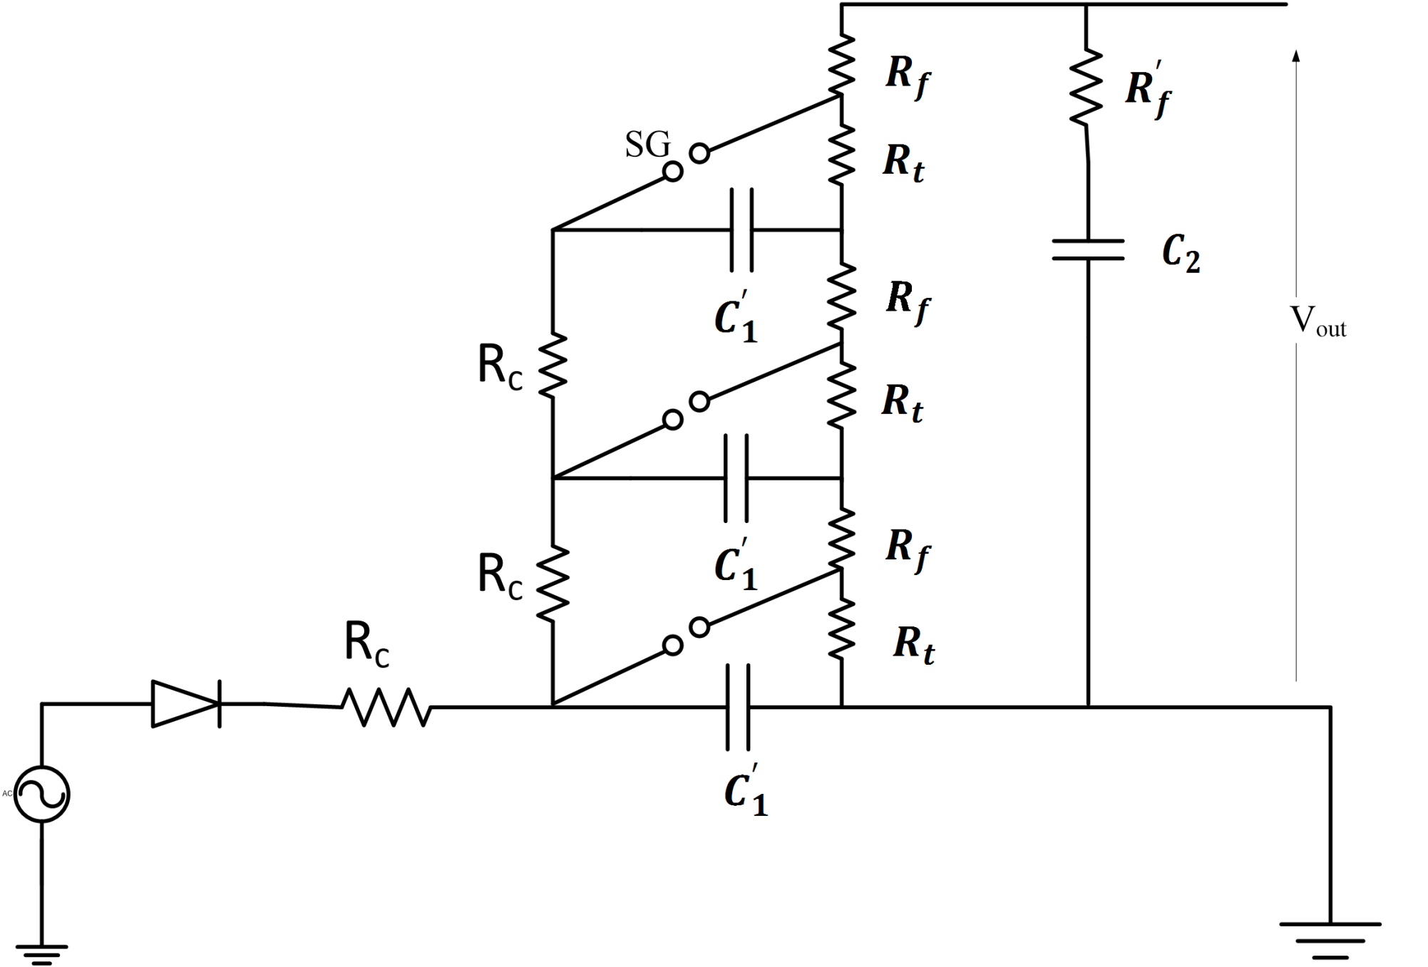
Marx impulse generator
Front current
Tail current

Slide 4

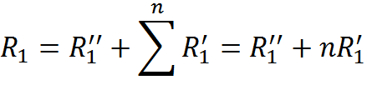
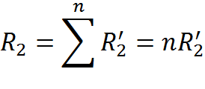
Equivalent parameters

Slide 5

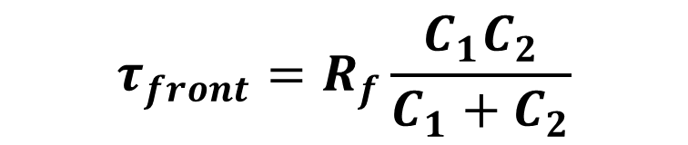
Front time constant:
$$τ_{front}=R_{f}\frac{C_{1}C_{2}}{C_{1}+C_{2}}$$
Tail time constant:
$$τ_{tail}=R_{t}\left(C_{1}+C_{2}\right)$$

Slide 6
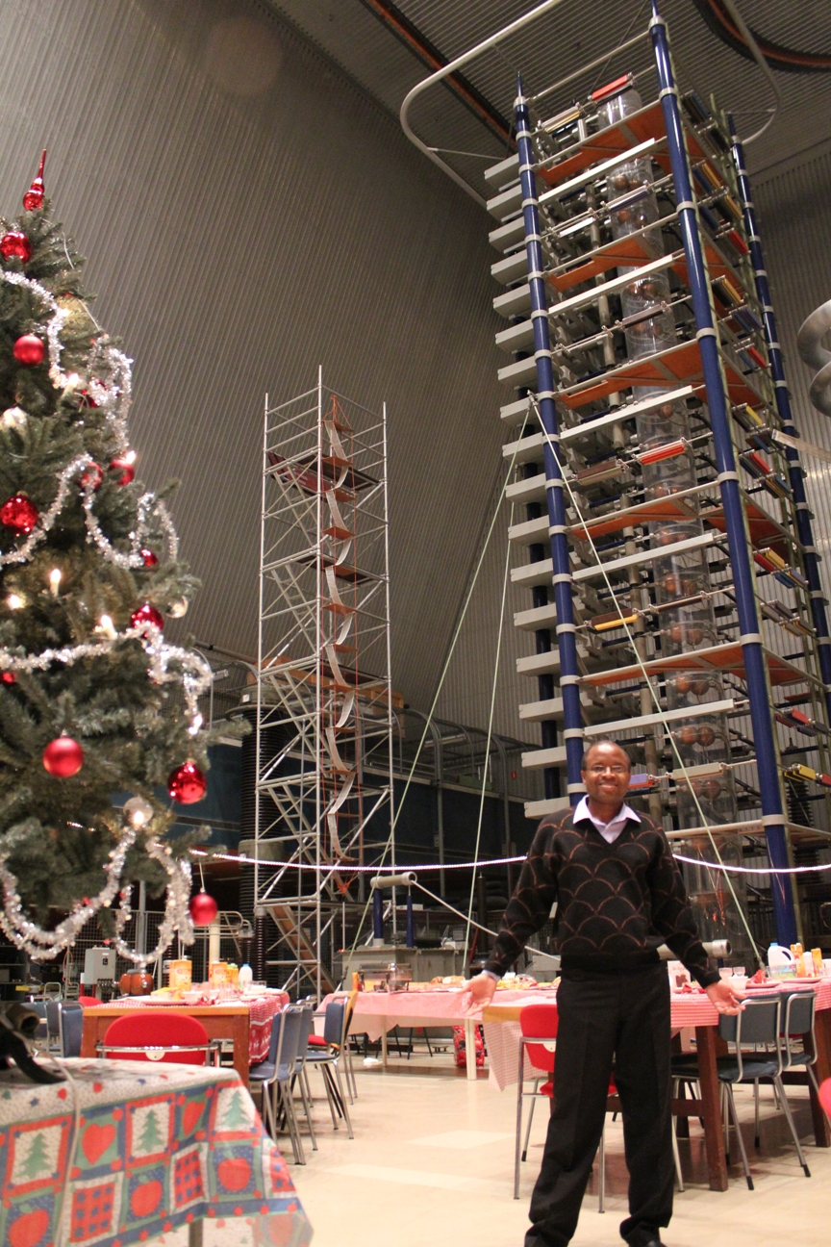

Slide 7
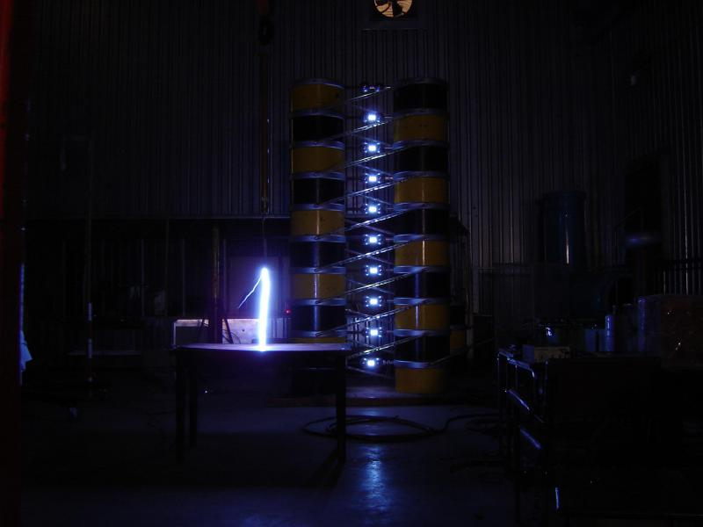

Slide 8
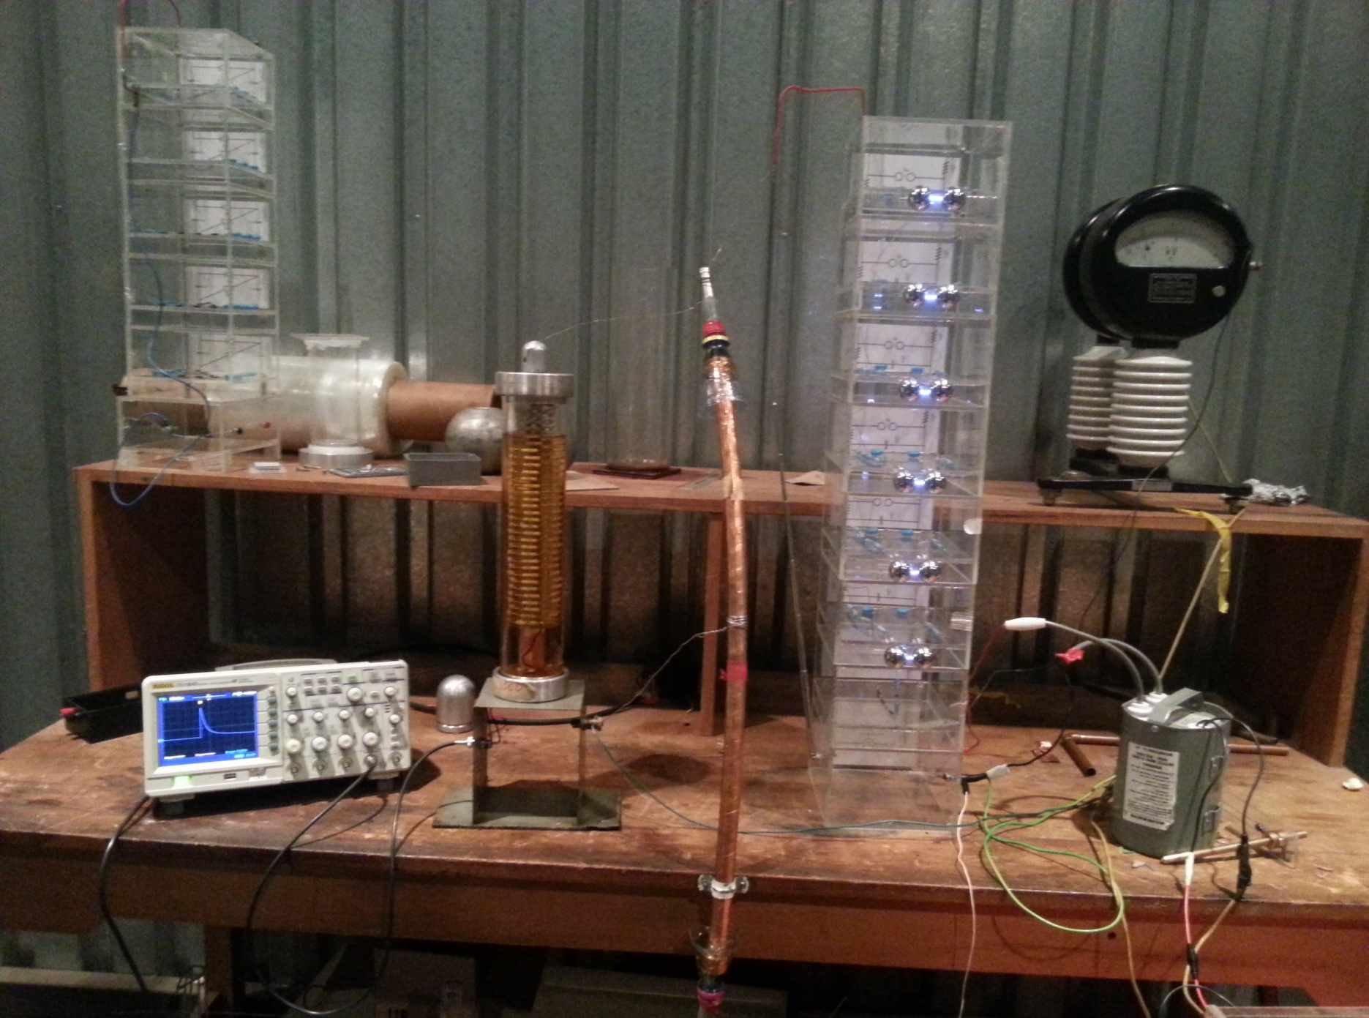

Slide 9
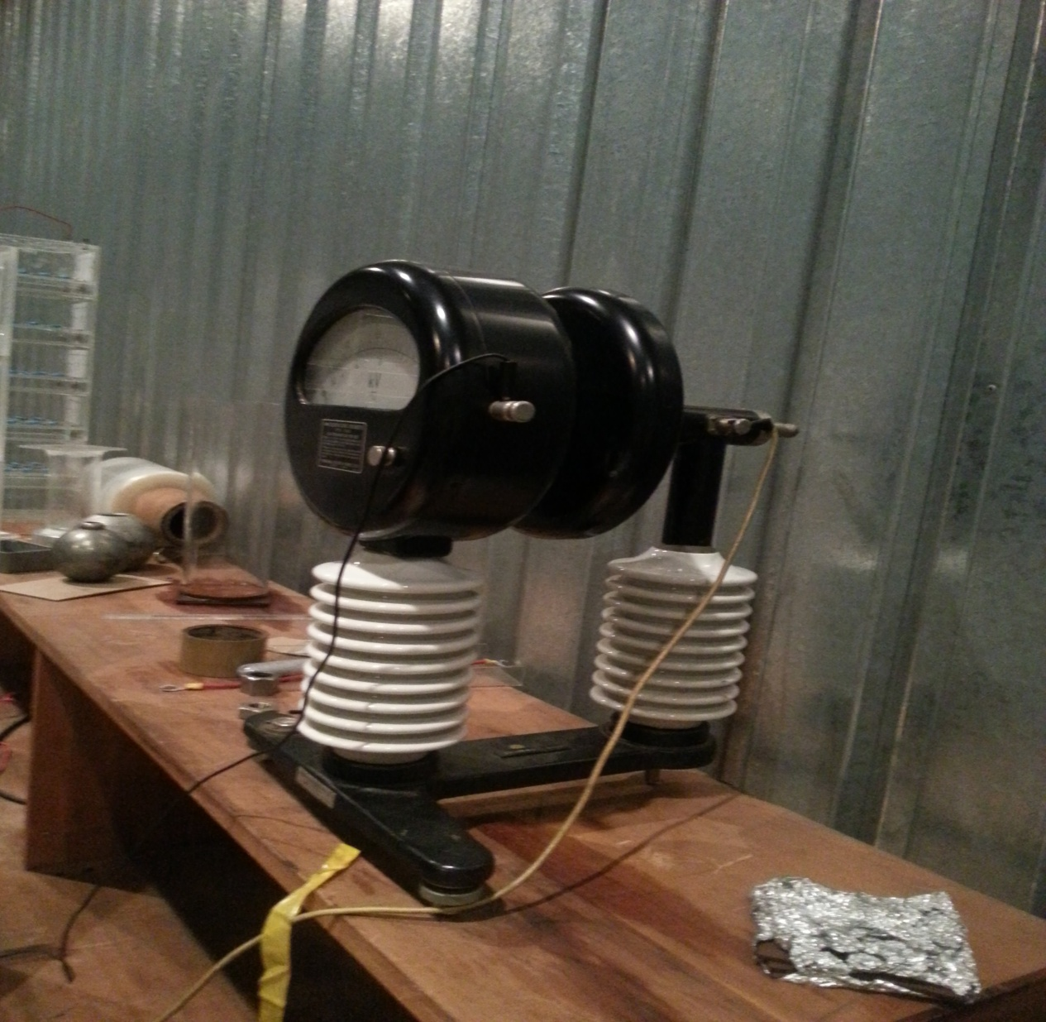
Electrostatic voltmeter

Slide 10
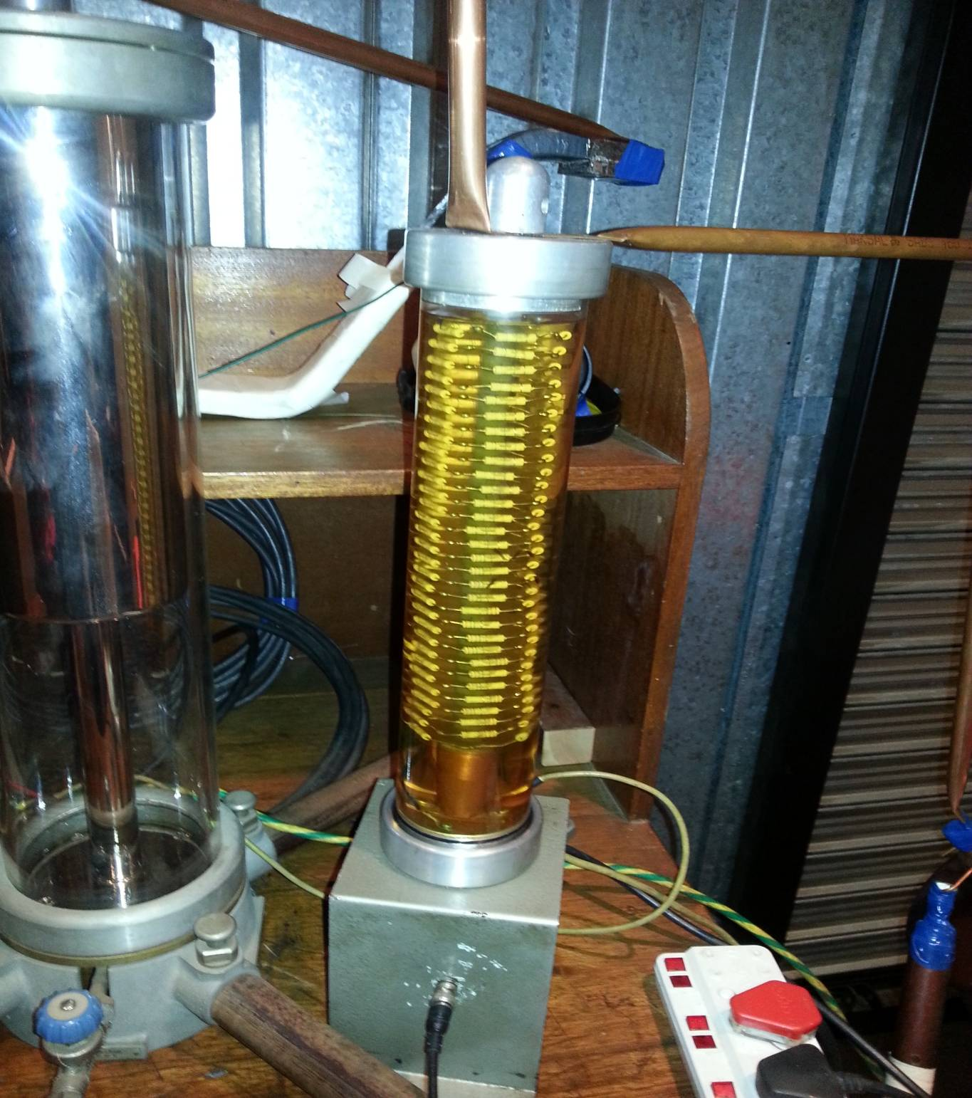
Resistive voltage divider

